Slide 1


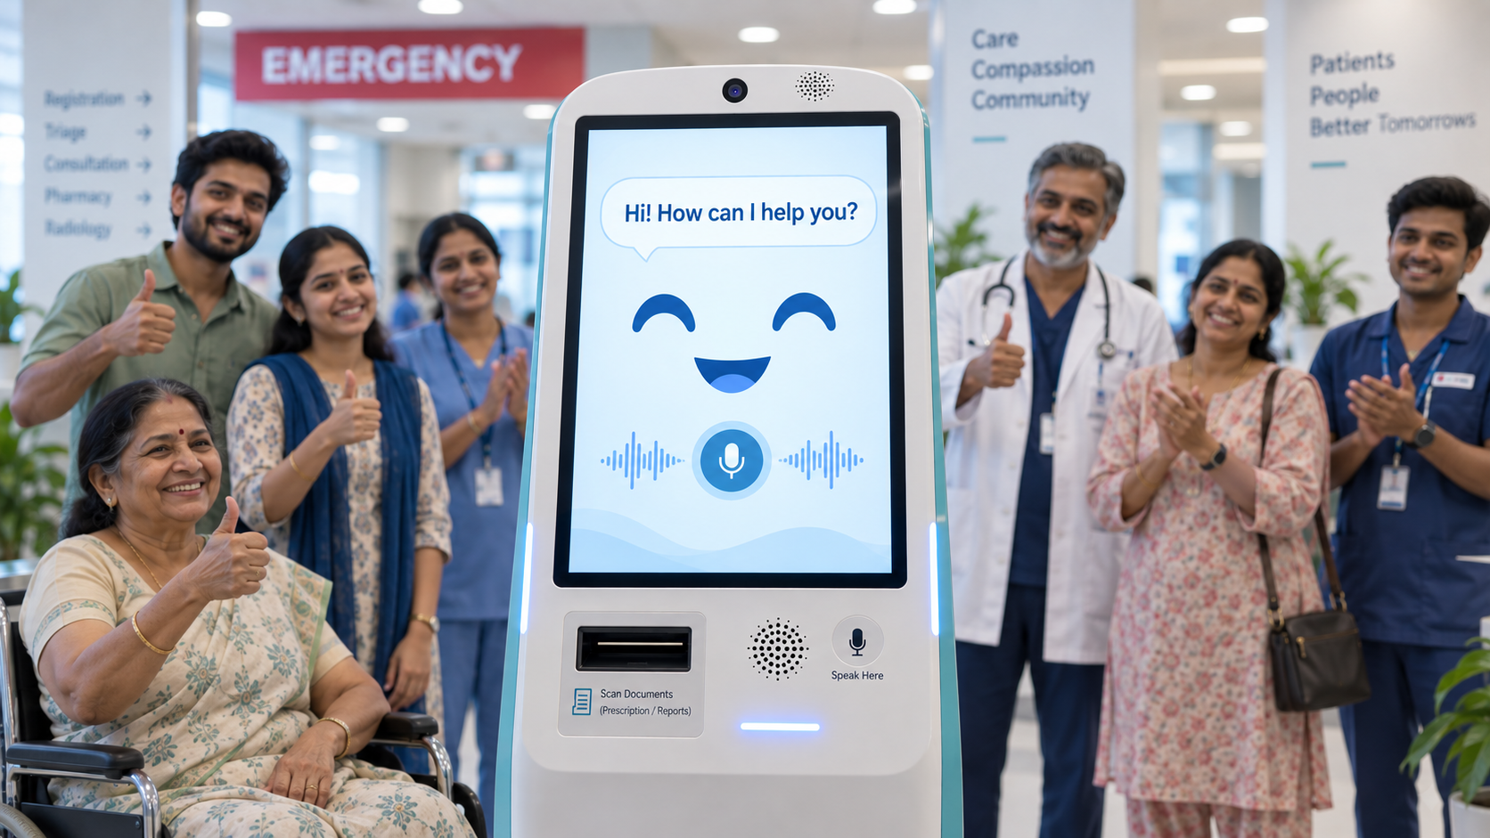

C.A.R.E.
Conversational Admission and Response Engine
TEAM NAME: starwars
Team Members:
Samiksha Sharma
Kumari Priyanshu
Krish Tomar
Dr Kshitij Kumar

Slide 2
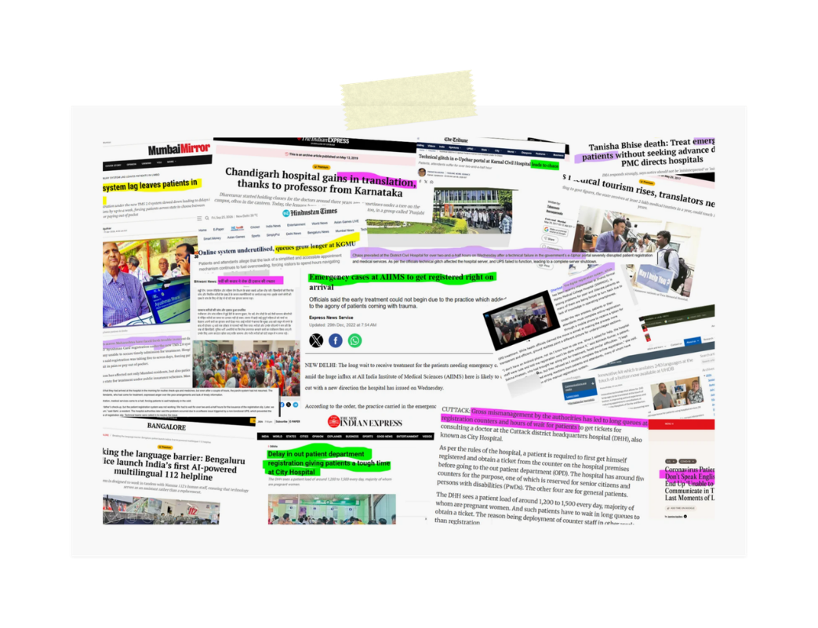
THE PROBLEM
Emergency patients should not wait for paperwork.
During an emergency:
  The patient may be in pain, unconscious or unable to speak.
  Family members are stressed and may struggle with long forms.
  Typing medical information takes valuable time.
  Language differences make communication harder.
  Doctors may not receive medical history immediately.
  Unclear prescriptions and incomplete details can create further delays.
Traditional intake processes can slow down the flow of critical information during emergencies, leading them to miss the golden time of treatment.

Slide 3
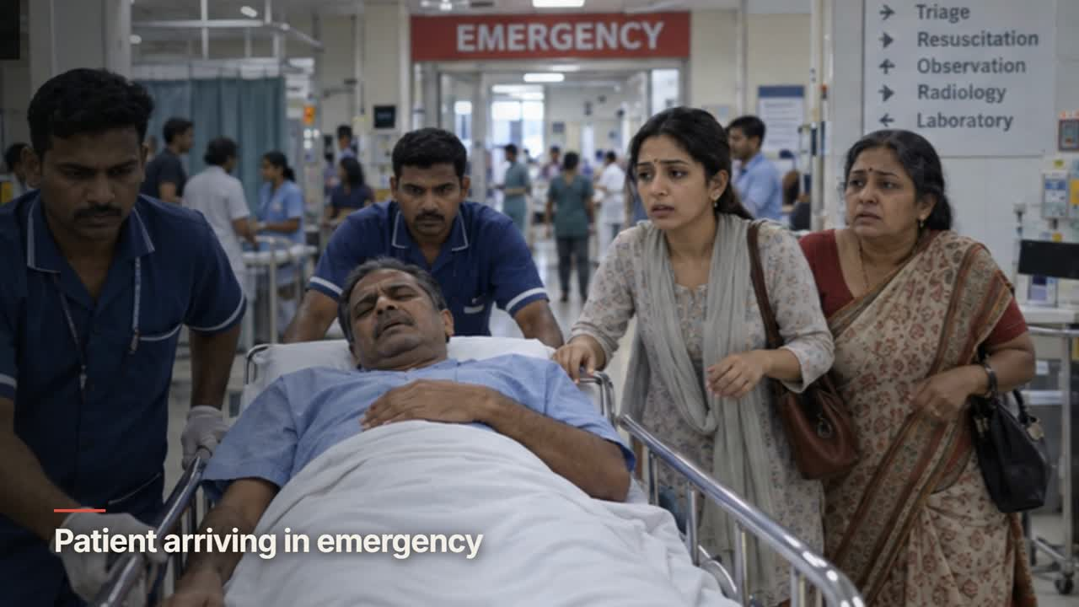

Slide 4
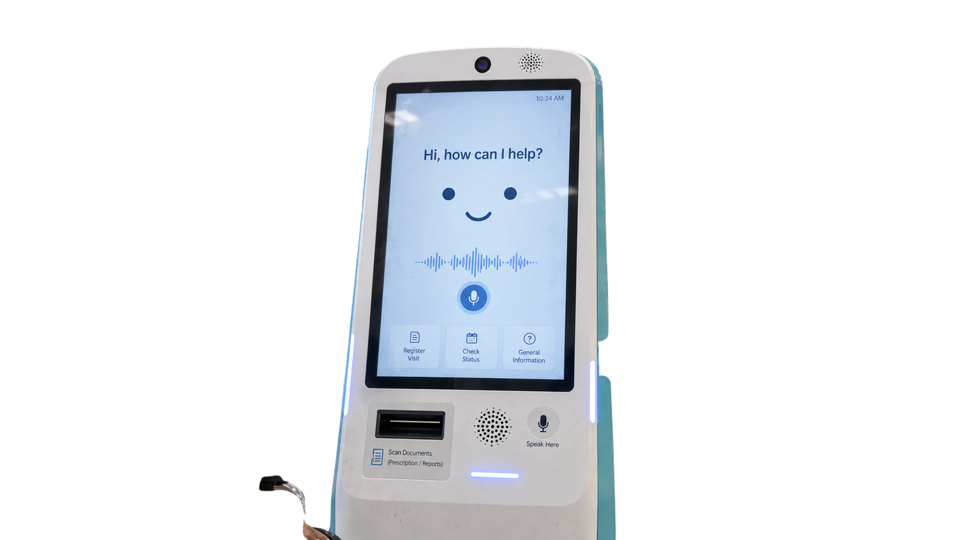
Automatic language detection
Multilingual support
The Emergency Voice Intake Assistant acts like a digital hospital receptionist. It:
  Asks intake questions through voice.
  Understands natural, free-form responses.
  Supports multiple Indian languages and mixed-language speech.
  Converts the conversation into structured patient information.
  Allows relatives to complete the intake while the patient receives treatment.
  Sends the collected information to hospital staff in real time.
Natural-language understanding
Family-assisted intake
Prescription and report scanning
Audio and visual accessibility
OUR SOLUTION
The system collects information. Medical professionals make all clinical decisions.
A conversational alternative to intake forms

Slide 5
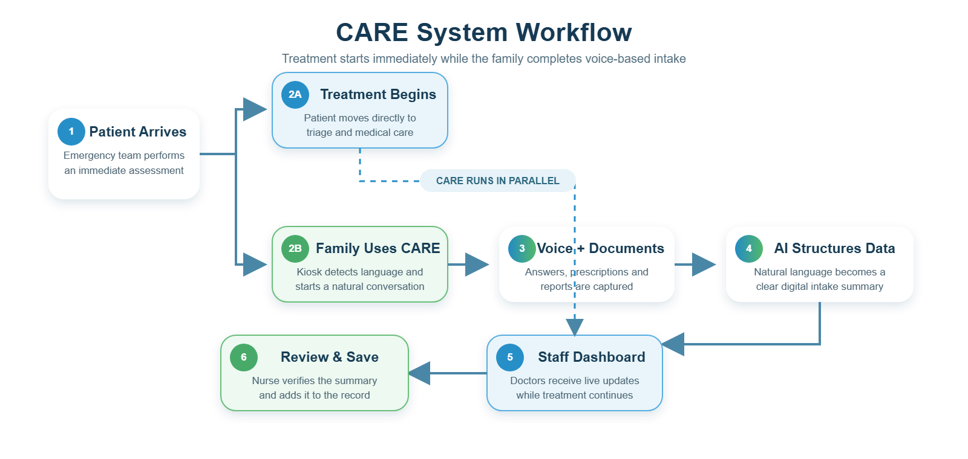
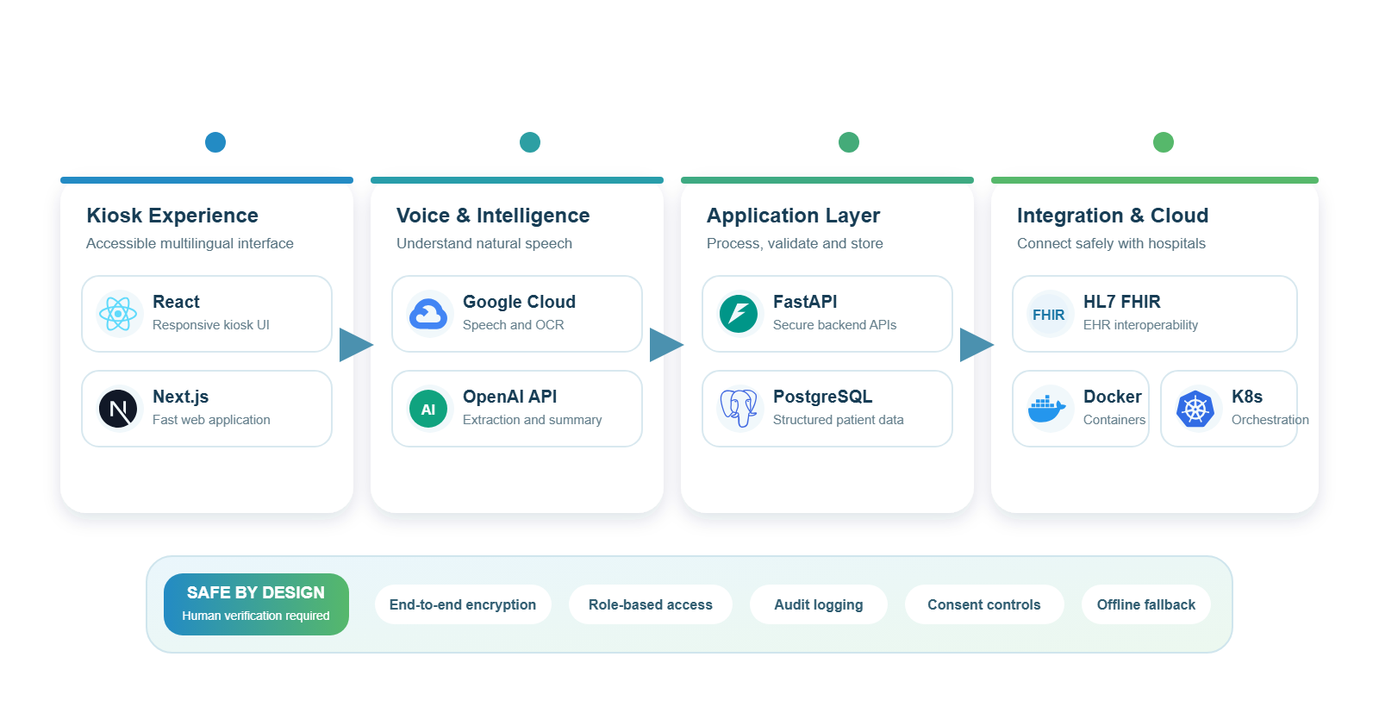
Proposed Technology Stack

Slide 6
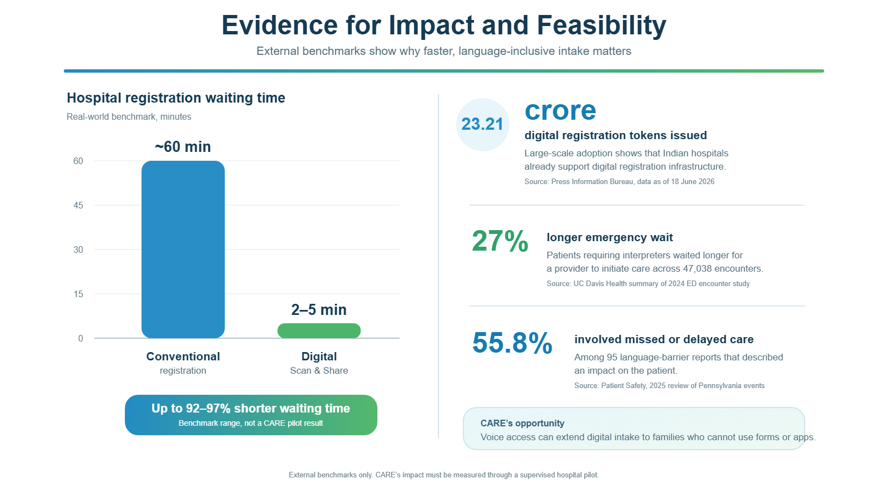
FEASIBILITY & VIABILITY

Slide 7
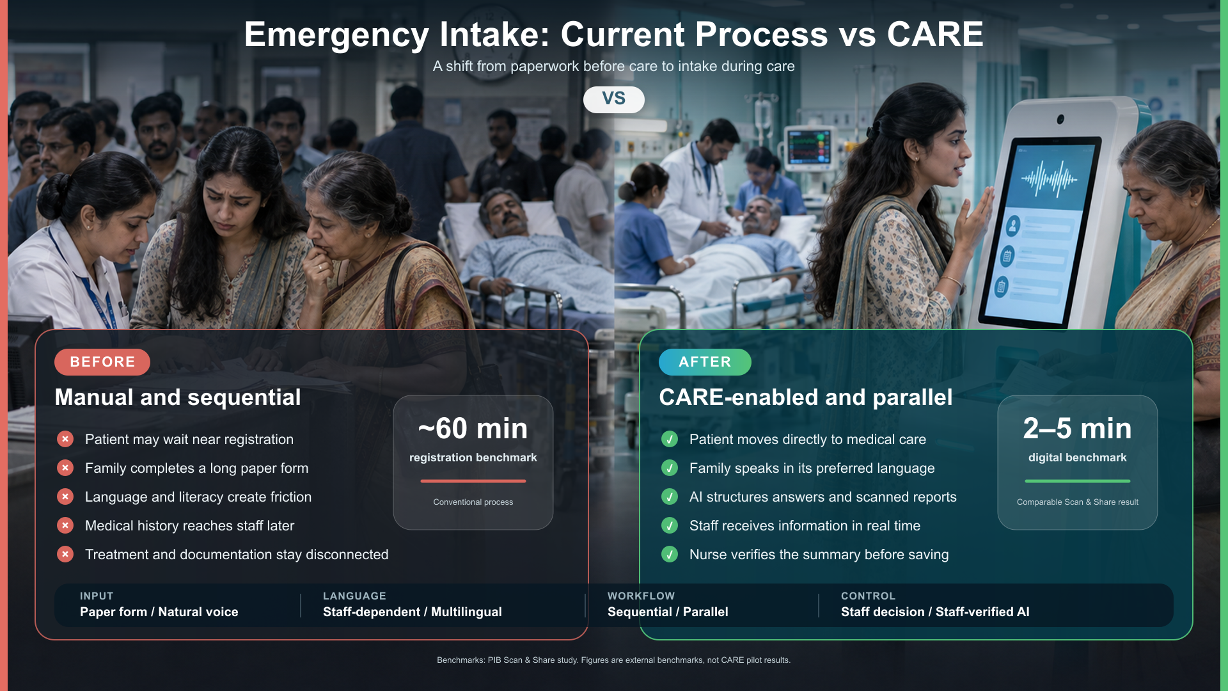

Slide 8

Thank
You

